Slide 1
Chapter 17. Applying Patterns to Design a Persistence Framework

Slide 2
Factory Method

Slide 3
Also Known As
Virtual Constructor
16-<number>

Slide 4
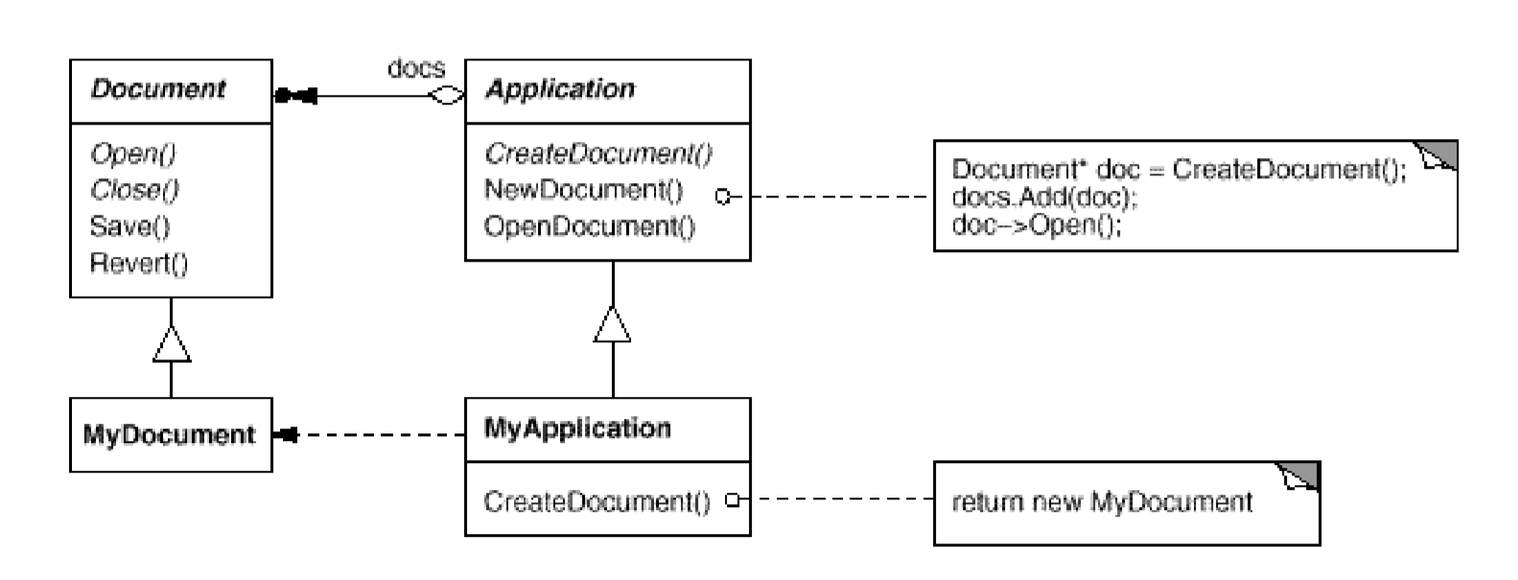
Motivation
The particular Document subclass to instantiate is application-specific, the Application class can't predict the subclass of Document to instantiate.
The Factory Method pattern encapsulates the knowledge of which Document subclass to create and moves this knowledge out of the framework.
Once an Application subclass is instantiated, it can then instantiate application-specific Documents without knowing their class. We call CreateDocument a factory method because it's responsible for "manufacturing" an object.
13-<number>

Slide 5
Applicability
Use the Factory Method pattern when
a class can't anticipate the class of objects it must create.
a class wants its subclasses to specify the objects it create.
classes delegate responsibility to one of several helper subclasses, and you want to localize the knowledge of which helper subclass is the delegate.
16-<number>

Slide 6
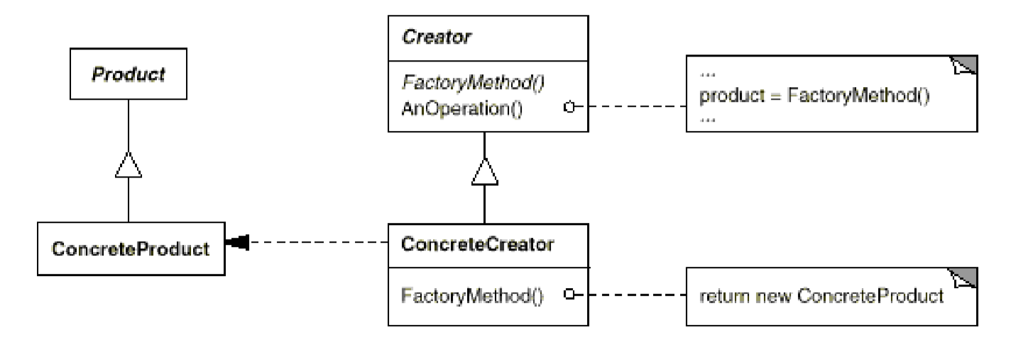
Structure
17-<number>

Slide 7
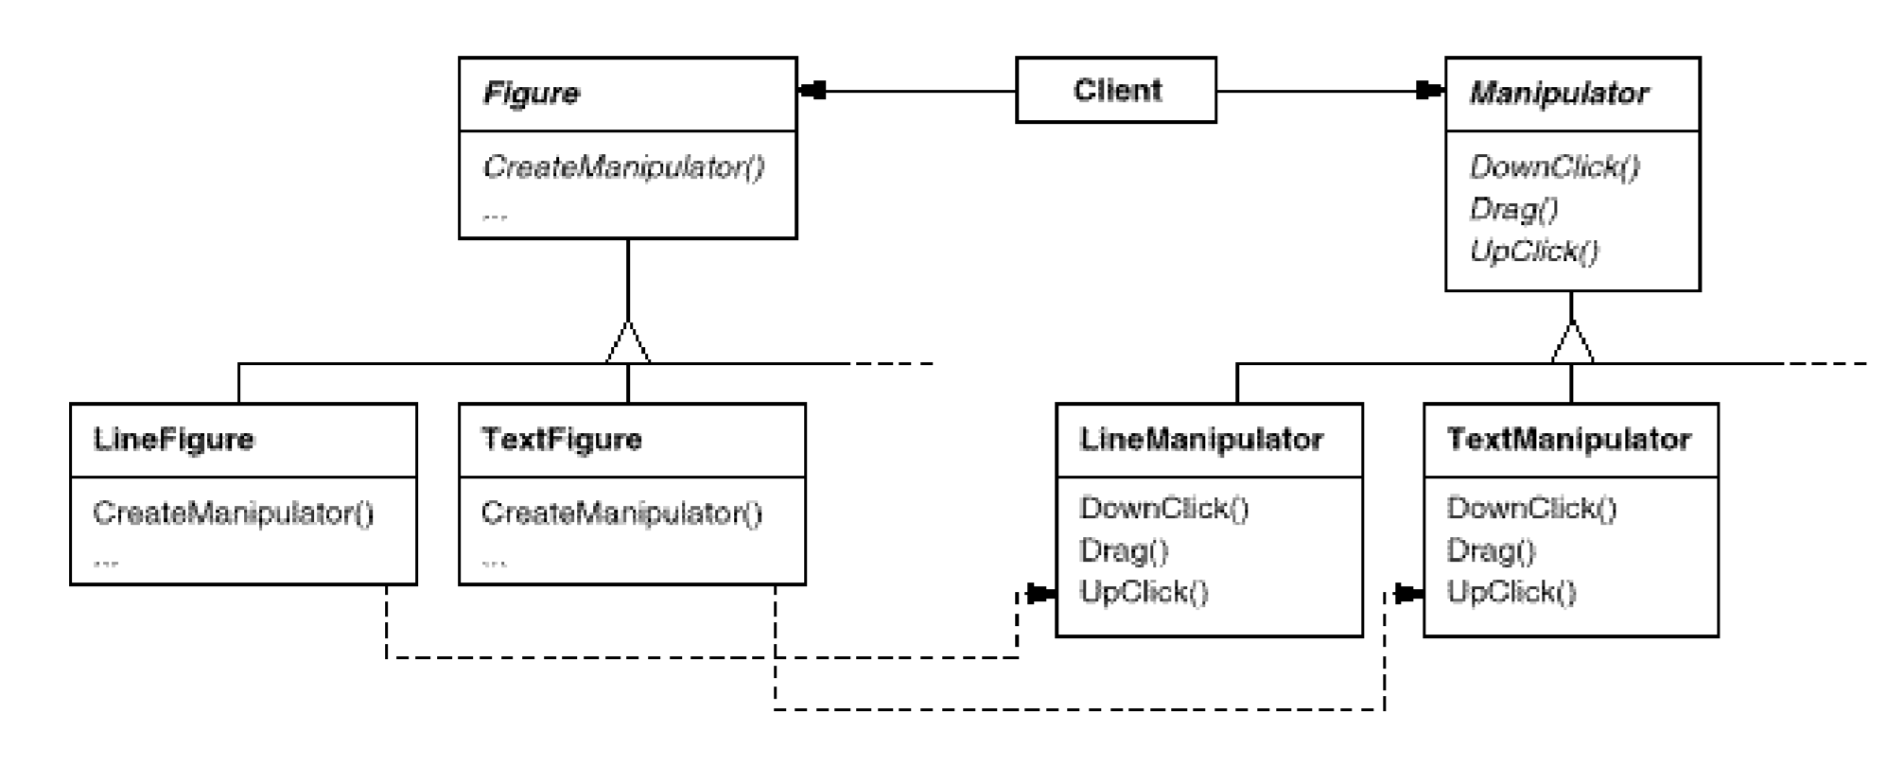
16-<number>

Slide 8
Intent
Define an interface for creating an object, but let the subclass decide which class to instantiate. Here, the word interface means to provide a contract/method to create an object.
Factory method lets a class defer instantiation to subclasses. This pattern involves “inheritance.”
17-<number>

Slide 9
Applicability
A class can’t anticipate the class of objects it must create.
A class wants its subclasses to specify the objects it creates
Classes delegate responsibility to one of several subclasses, and you want to localize the knowledge of which helper subclass is the delegate.
17-<number>

Slide 10
How do I realize the need for Factory Pattern?
If there is an inheritance hierarchy, where a polymorphic creation is needed.
If you end up writing lots of if/else blocks when deciding which concrete class to create.
If you end up writing lots of switch statements when deciding which concrete class to create.
If you are unsure which concrete implementation of an interface to return.
17-<number>

Slide 11
Consequence
Provides hooks for subclasses. Creating objects inside a class with a factory method is always more flexible than creating an object directly. Factory Method gives subclasses a hook for providing an extended version of an object.
Connects parallel class hierarchies.
17-<number>

Slide 12
Template Method
Factory Method Pattern
Factory
method
AbstractClass
normalMethod()
makeObj(args)
: Product
Product
Product 1
Product 2
Concrete1
Concrete2
create
makeObj(args)
: Product
makeObj(args)
: Product
create
return new Product1();
return new Product2();
17-<number>

Slide 13
Template Method
Factory Method Pattern
Factory
method
Creator
normalMethod()
makeObj(args)
: Product
Product
Product 1
Product 2
Creator A
Creator B
create
makeObj(args)
: Product
makeObj(args)
: Product
create
return new Product1();
return new Product2();
17-<number>

Slide 14
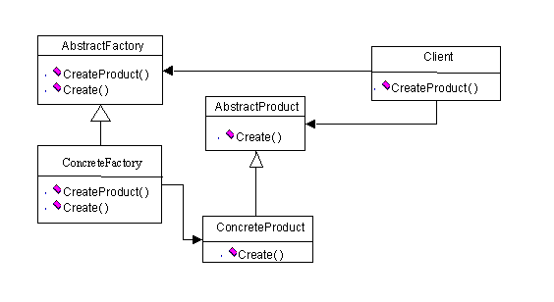
Simple Factory
17-<number>

Slide 15
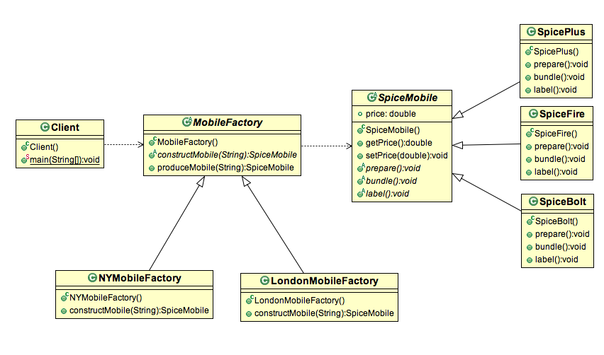
Simple Factory
17-<number>

Slide 16
Persistence Framework: Putting It Together
Controller
DBMgr
DB Access Interface
Net Interface
getX(): X
saveX(x:X)
getX(): X
saveX(x:X)
openSocket()
closeSocket()
calls hook1() and hook2()
DBX Cmd
DBX Access
DBY Proxy
Remote DBY
execute(): Object
hook1()
hook2(): Object
getX(): X
saveX(x:X)
getX(): X
saveX(x:X)
openSocket()
closeSocket()
getX(): X
saveX(x:X)
openSocket()
closeSocket()
bridge
Get X
Save X
remote proxy
GetX(...)
hook1()
hook2(): Object
SaveX(...)
hook1()
hook2(): Object
command, template method and factory method
17-<number>

